Slide 1
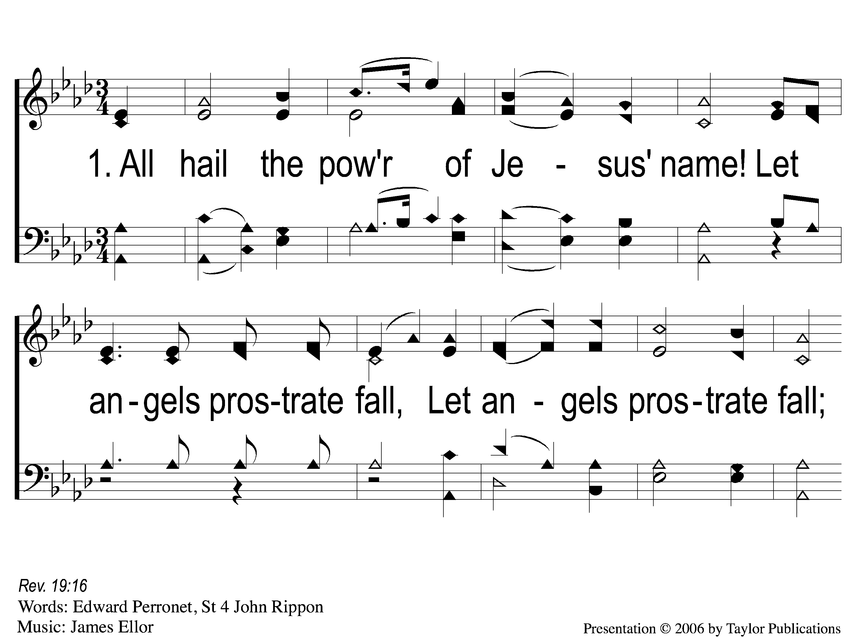
1-1 All Hail the Power of Jesus’ Name
All Hail the Power Of Jesus’ Name
145

Slide 2
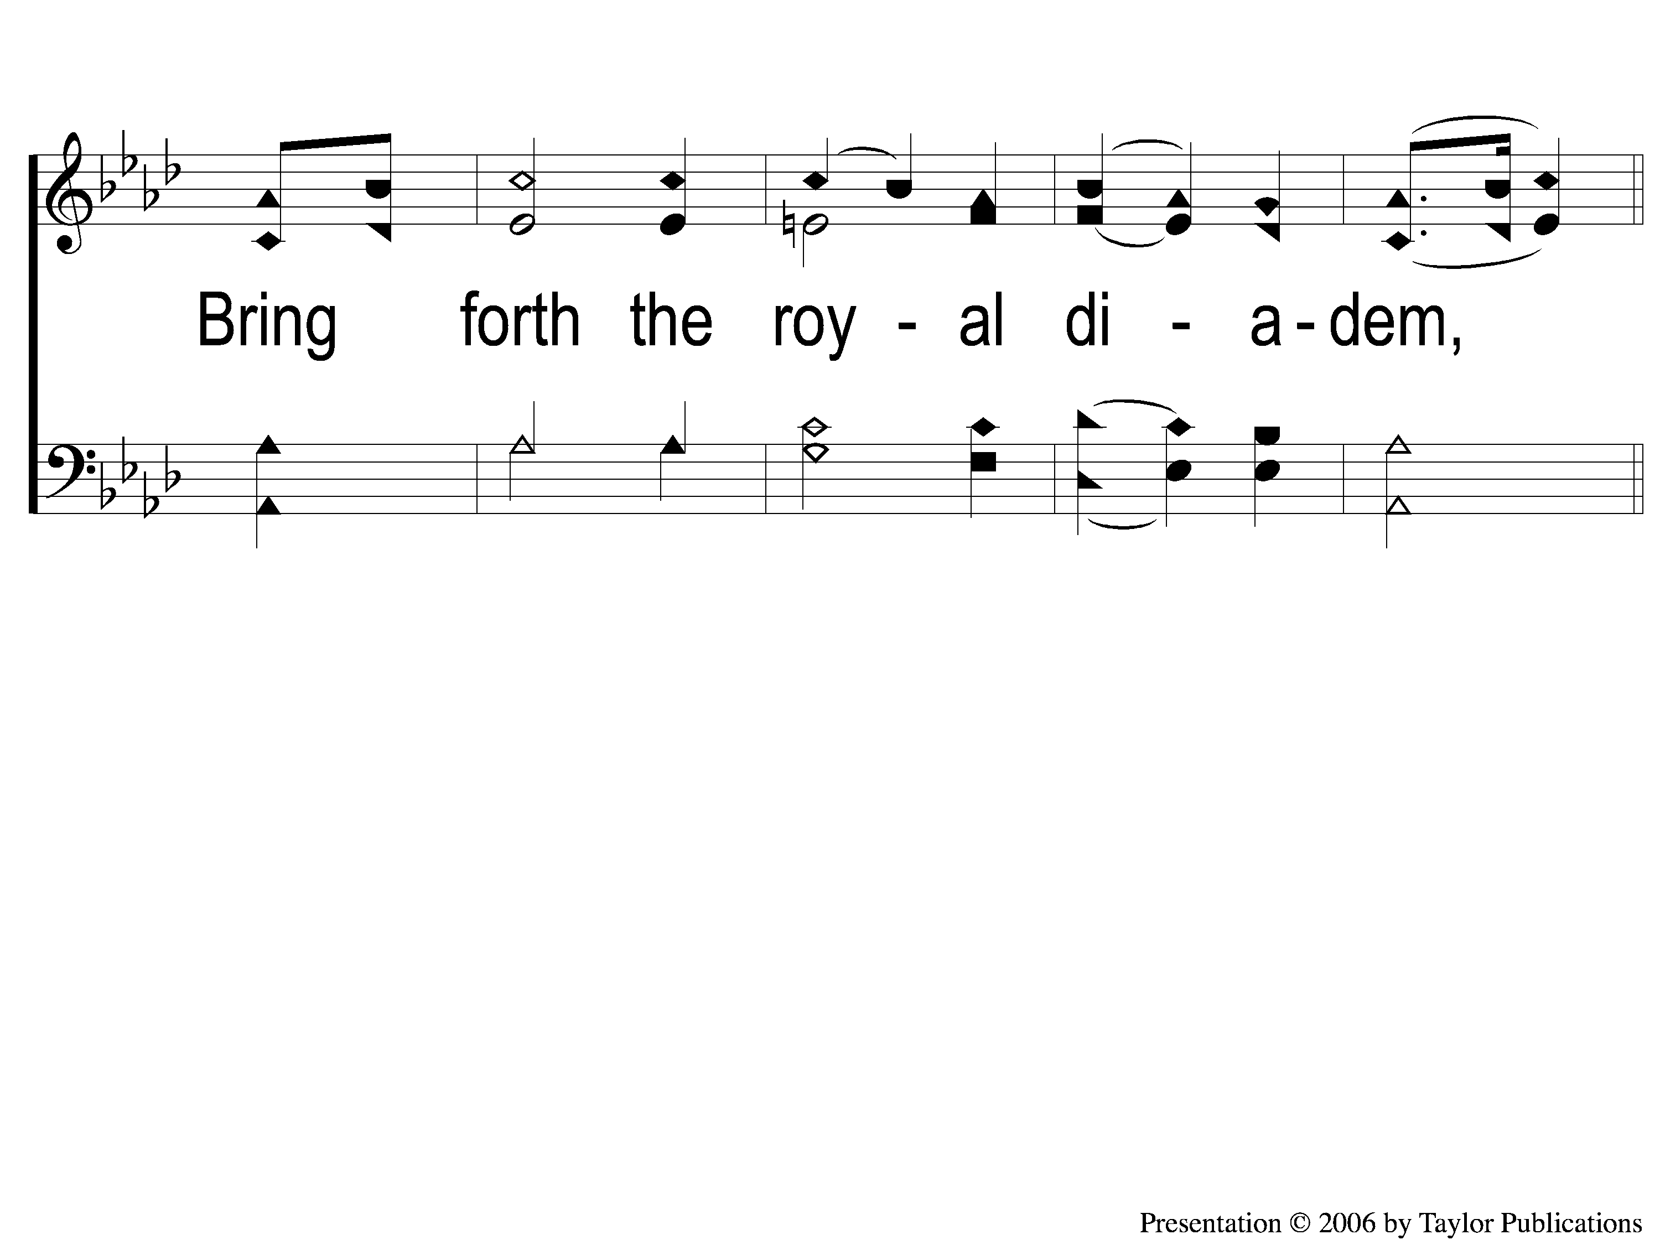
1-2 All Hail the Power of Jesus’ Name
All Hail the Power Of Jesus’ Name
145

Slide 3
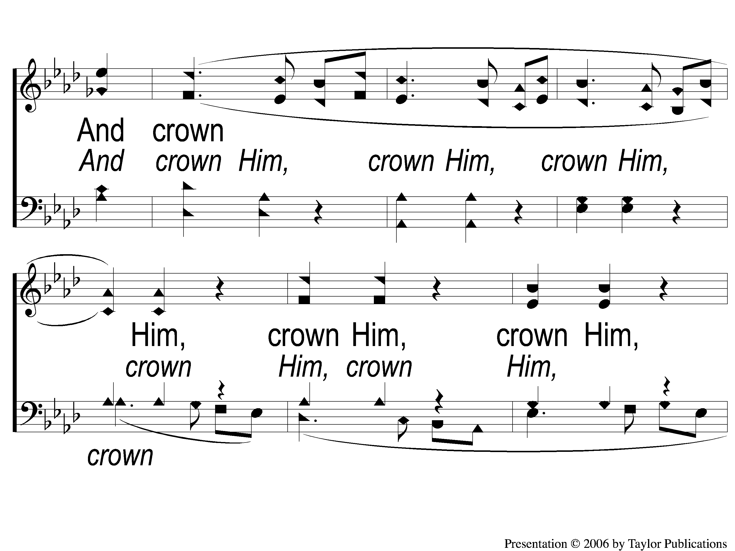
1C-1 All Hail the Power of Jesus’ Name
All Hail the Power Of Jesus’ Name
145

Slide 4
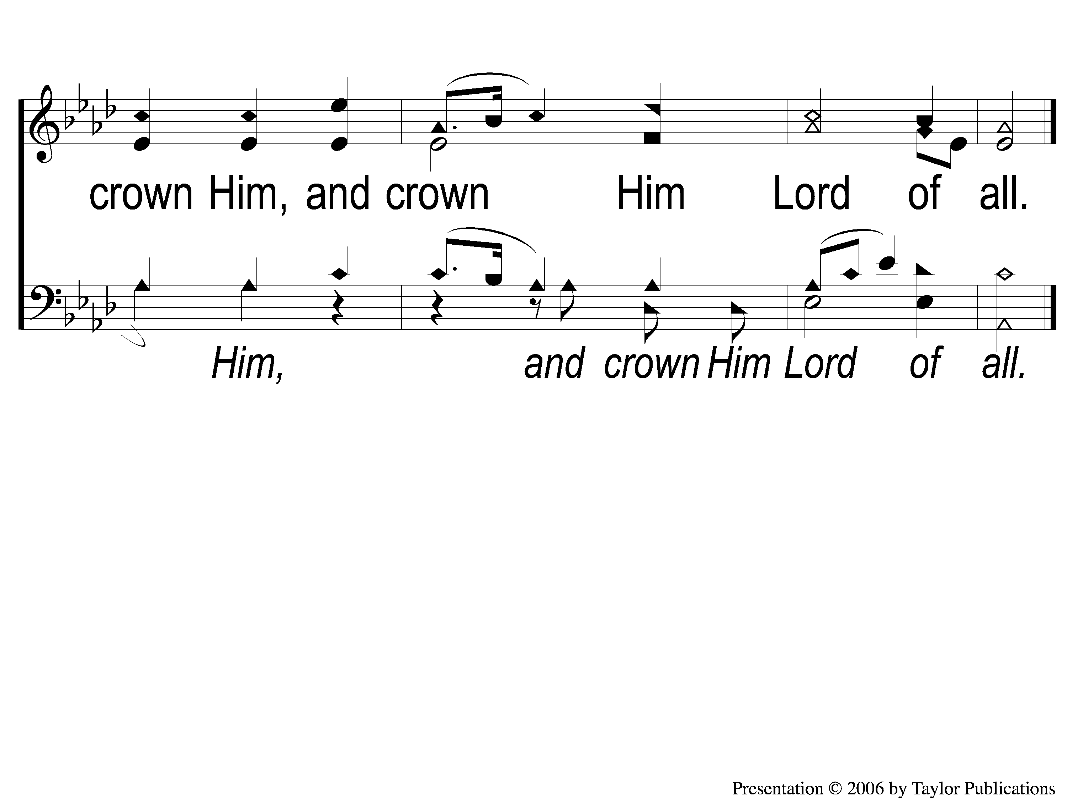
1C-2 All Hail the Power of Jesus’ Name
All Hail the Power Of Jesus’ Name
145

Slide 5
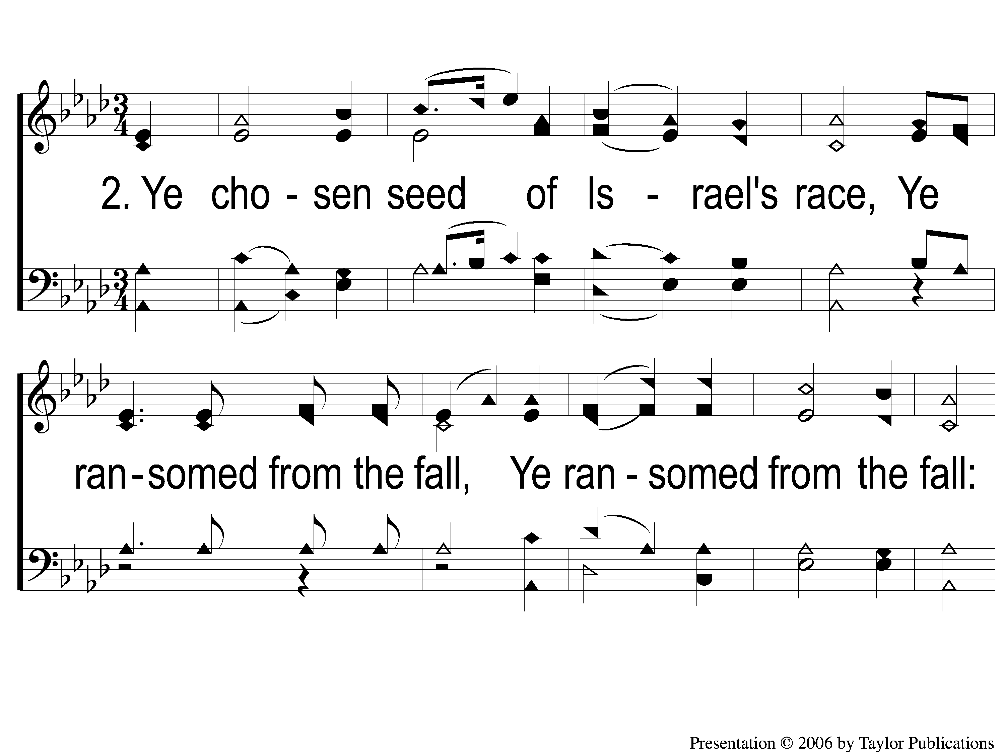
2-1 All Hail the Power of Jesus’ Name
All Hail the Power Of Jesus’ Name
145

Slide 6
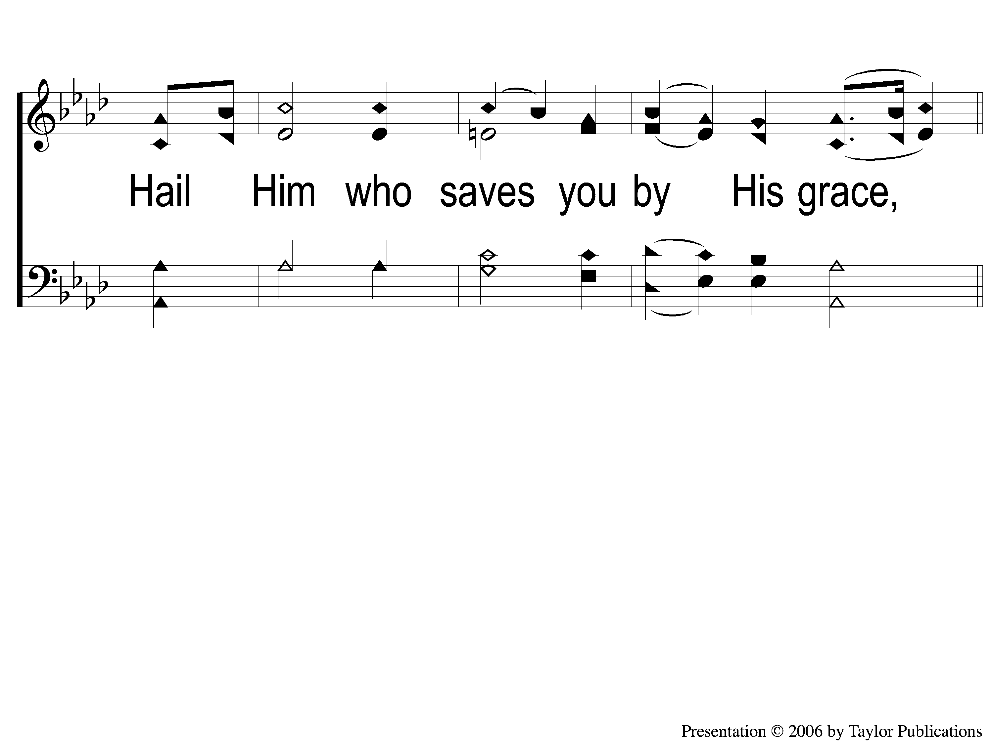
2-2 All Hail the Power of Jesus’ Name
All Hail the Power Of Jesus’ Name
145

Slide 7
1C-1 All Hail the Power of Jesus’ Name
All Hail the Power Of Jesus’ Name
145

Slide 8
1C-2 All Hail the Power of Jesus’ Name
All Hail the Power Of Jesus’ Name
145

Slide 9
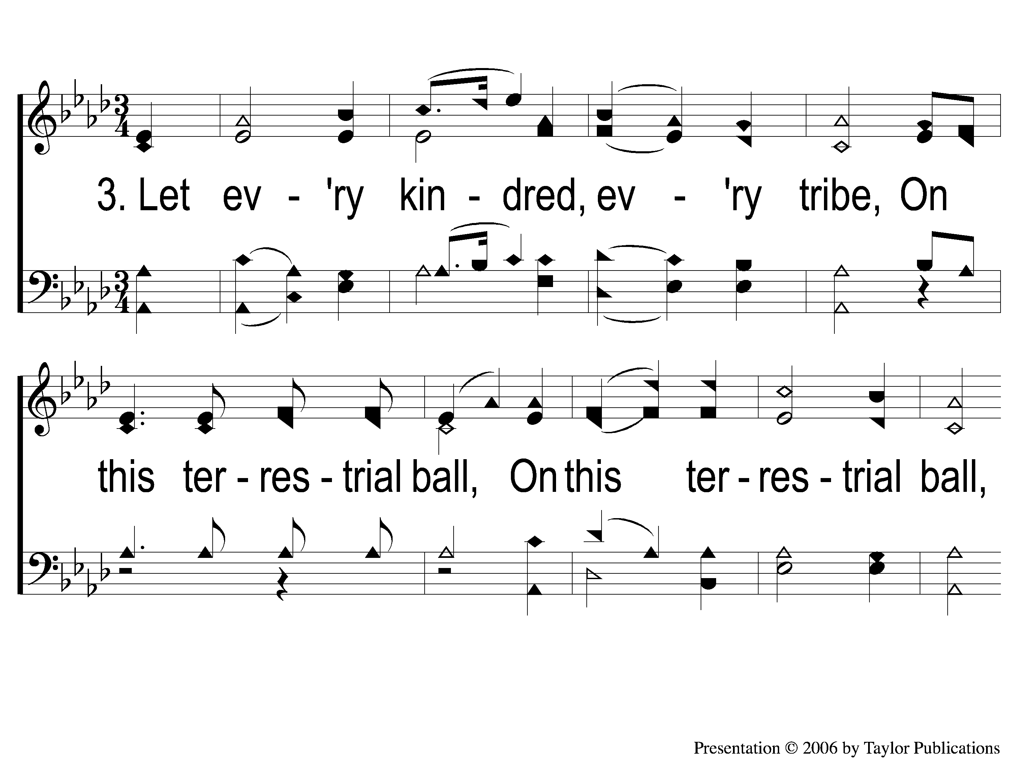
3-1 All Hail the Power of Jesus’ Name
All Hail the Power Of Jesus’ Name
145

Slide 10
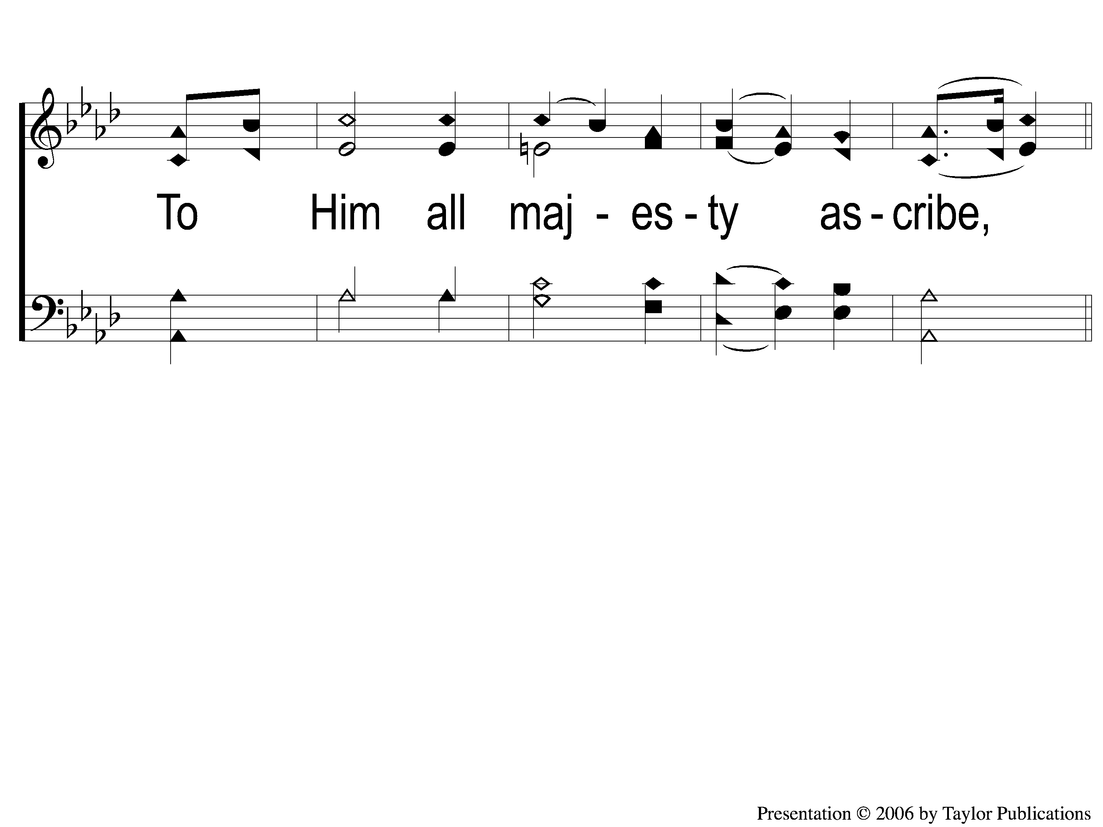
3-2 All Hail the Power of Jesus’ Name
All Hail the Power Of Jesus’ Name
145

Slide 11
1C-1 All Hail the Power of Jesus’ Name
All Hail the Power Of Jesus’ Name
145

Slide 12
1C-2 All Hail the Power of Jesus’ Name
All Hail the Power Of Jesus’ Name
145

Slide 13
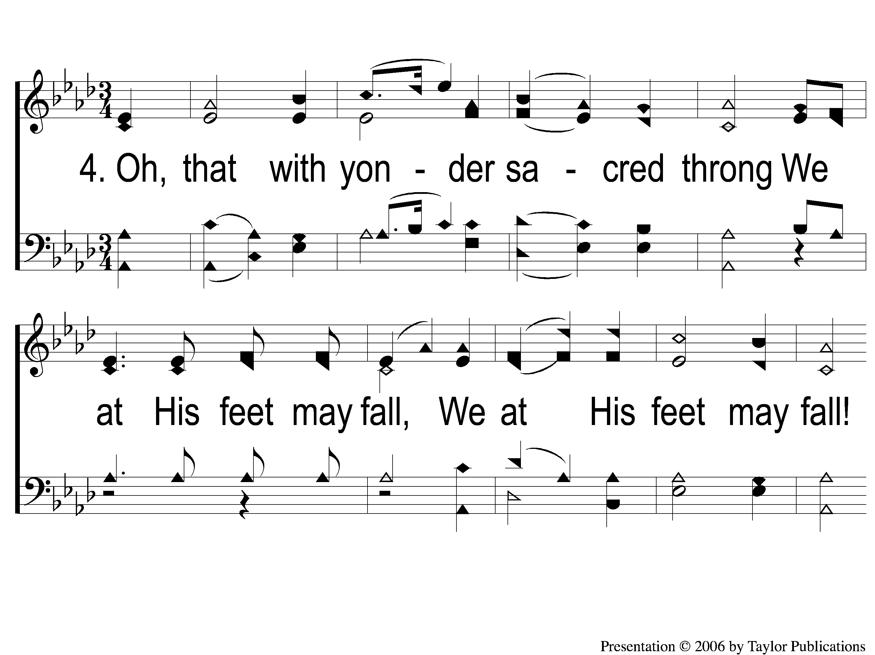
4-1 All Hail the Power of Jesus’ Name
All Hail the Power Of Jesus’ Name
145

Slide 14
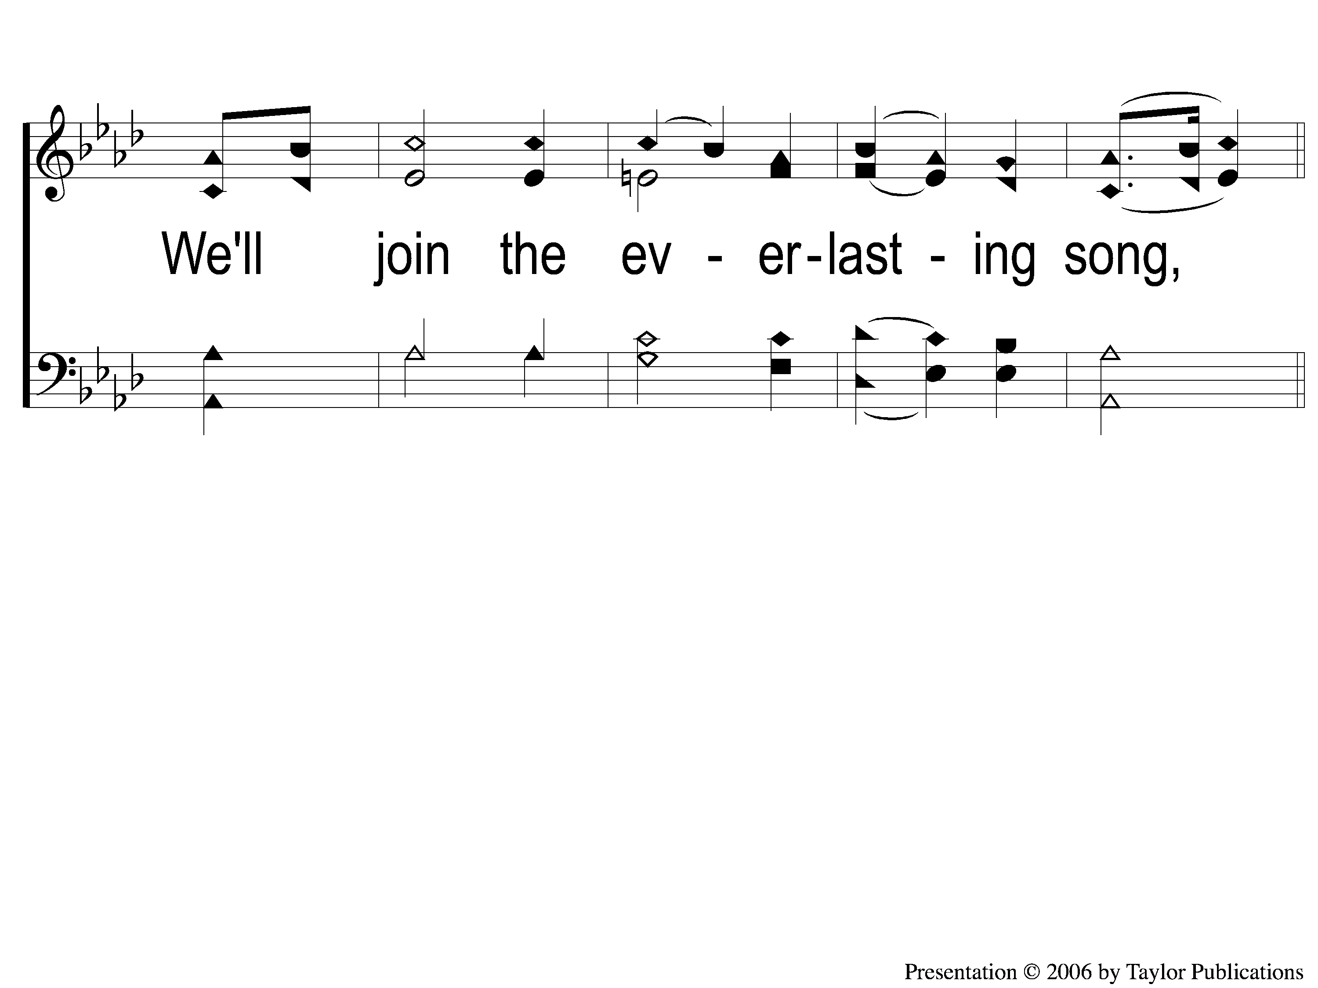
4-2 All Hail the Power of Jesus’ Name
All Hail the Power Of Jesus’ Name
145

Slide 15

2C-1 All Hail the Power of Jesus’ Name
All Hail the Power Of Jesus’ Name
145

Slide 16
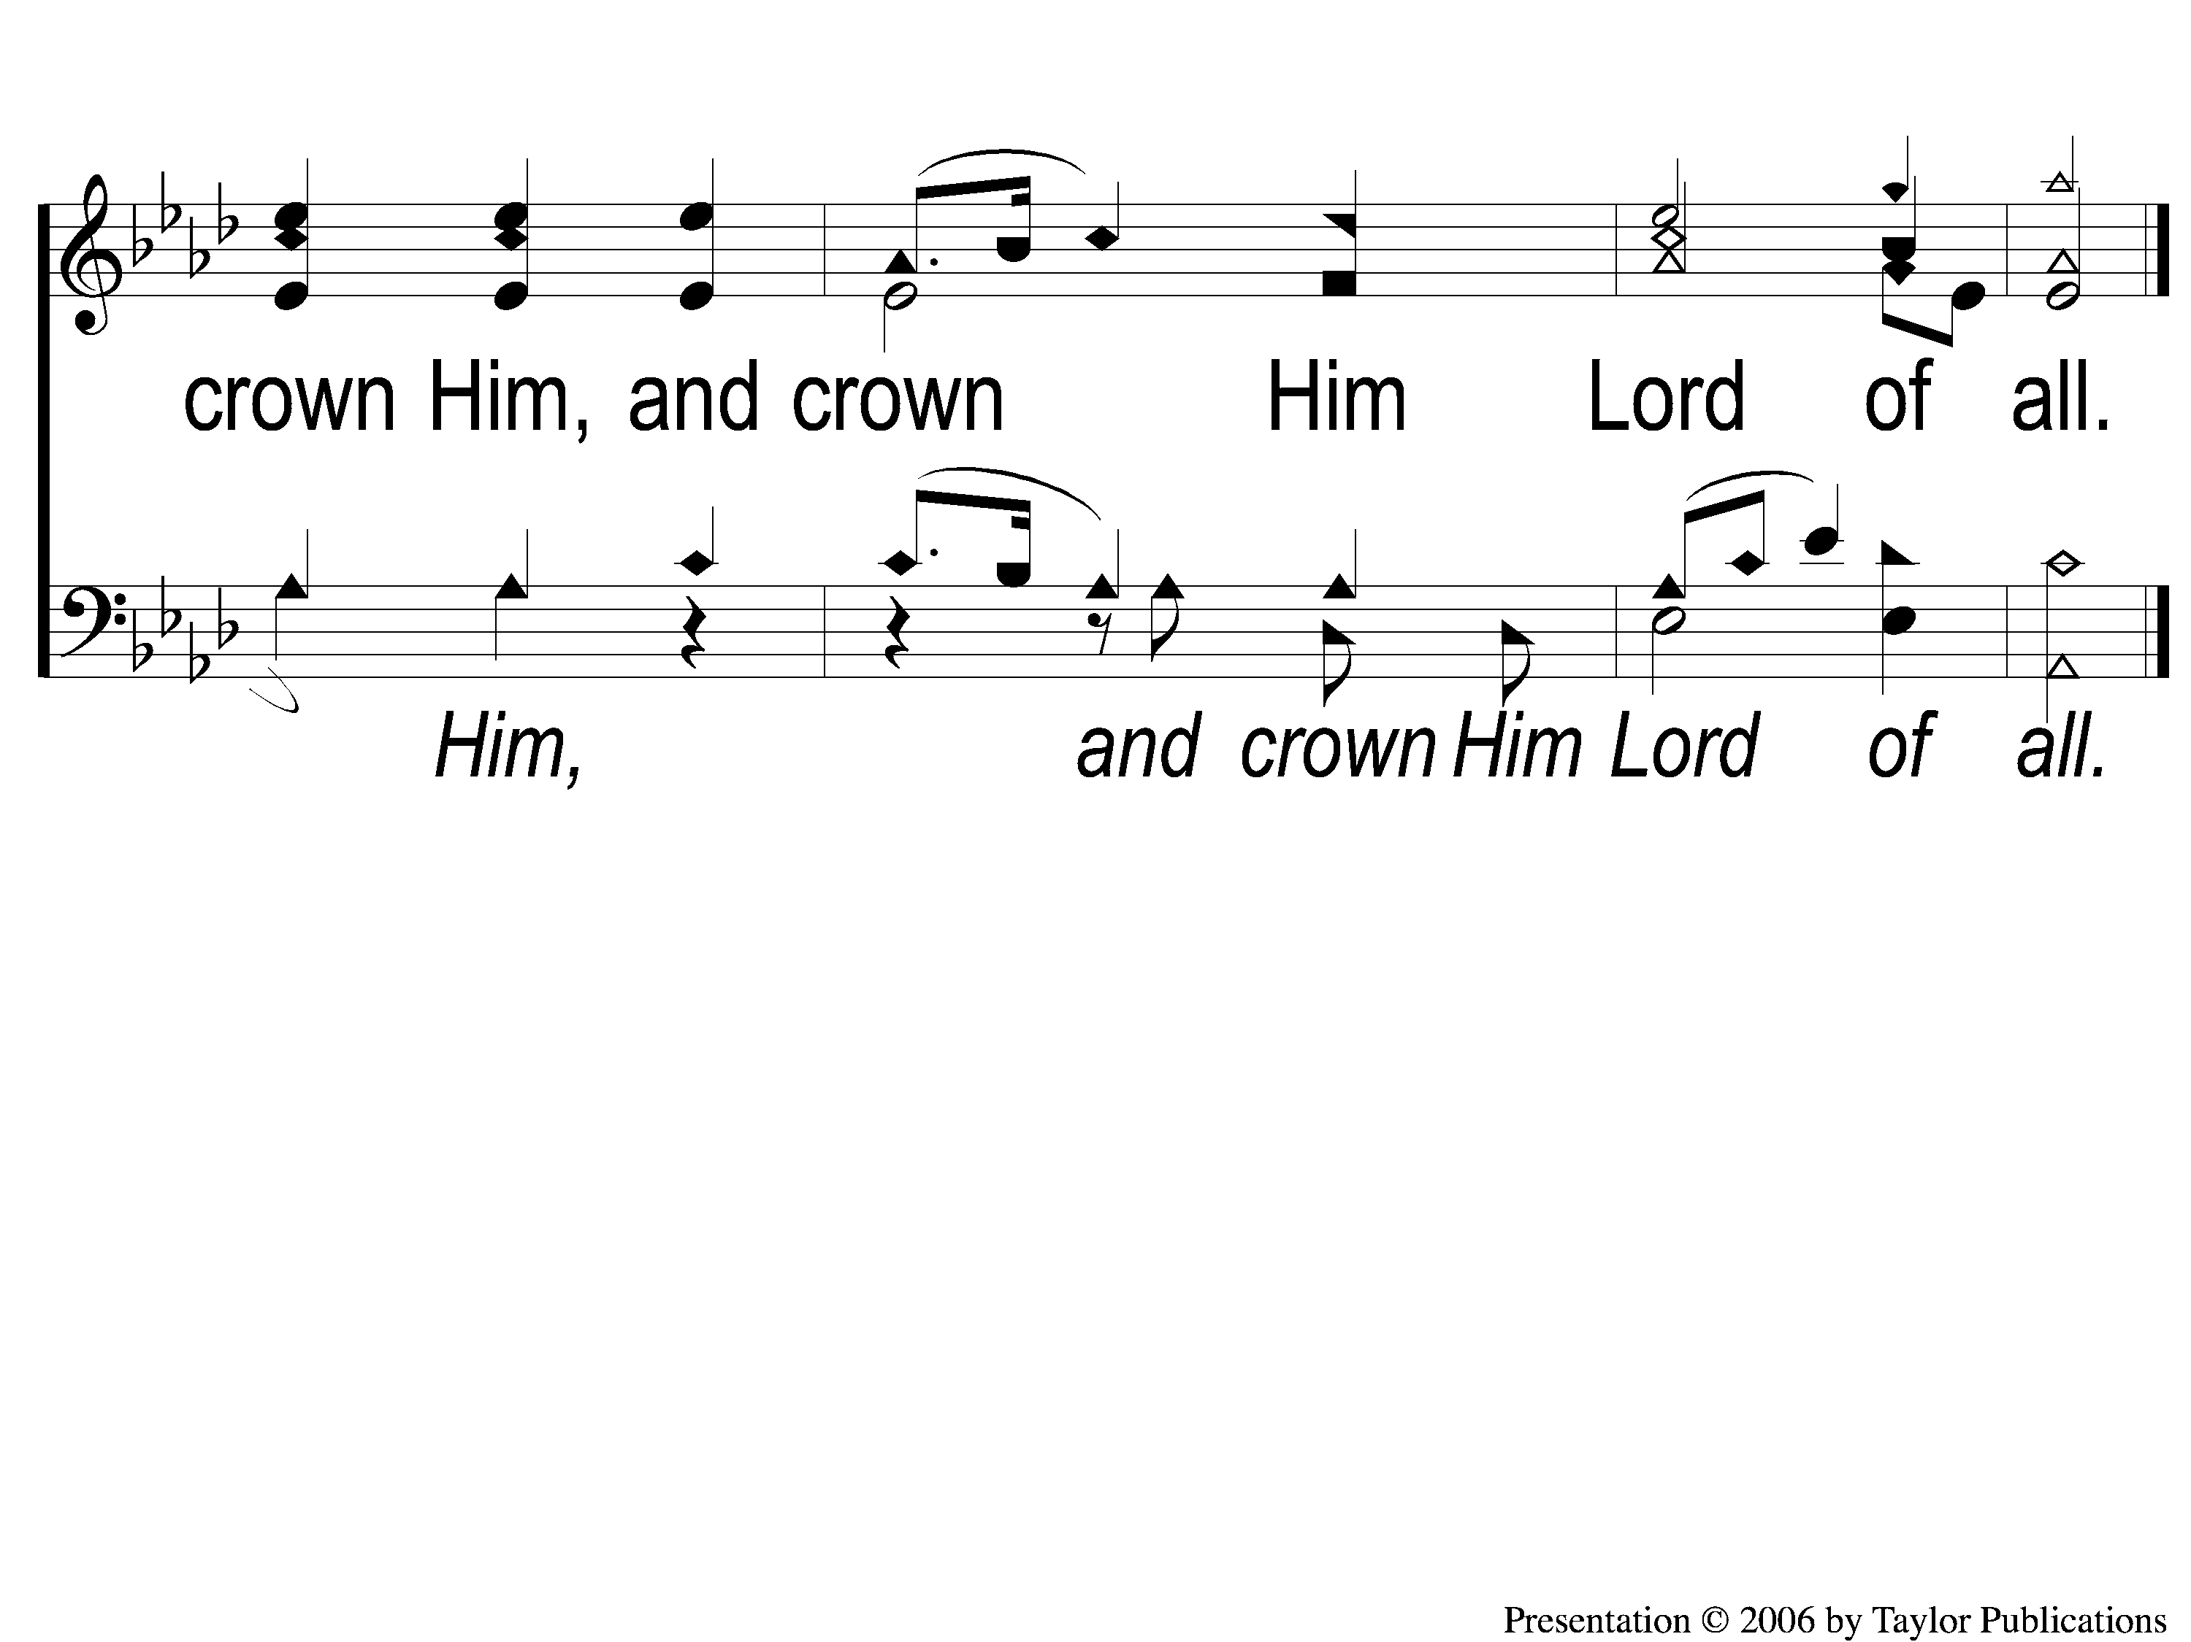
2C-2 All Hail the Power of Jesus’ Name
All Hail the Power Of Jesus’ Name
145

